Slide 1
Employee Attrition Prediction

Slide 2

Employee Attrition
Employee attrition is the practice of leaving roles unfilled following workers’ departures. Employers will often eliminate positions, restructure departments, or implement a hiring freeze instead of bringing on new staff. There are many reasons for employee attrition, including cost-saving and organizational change.

Slide 3
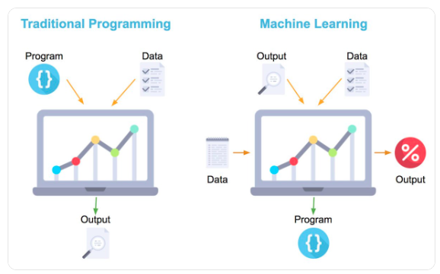
Methodology Used
Machine learning is a branch of artificial intelligence (AI) and computer science which focuses on the use of data and algorithms to imitate the way that humans learn, gradually improving its accuracy.

Slide 4
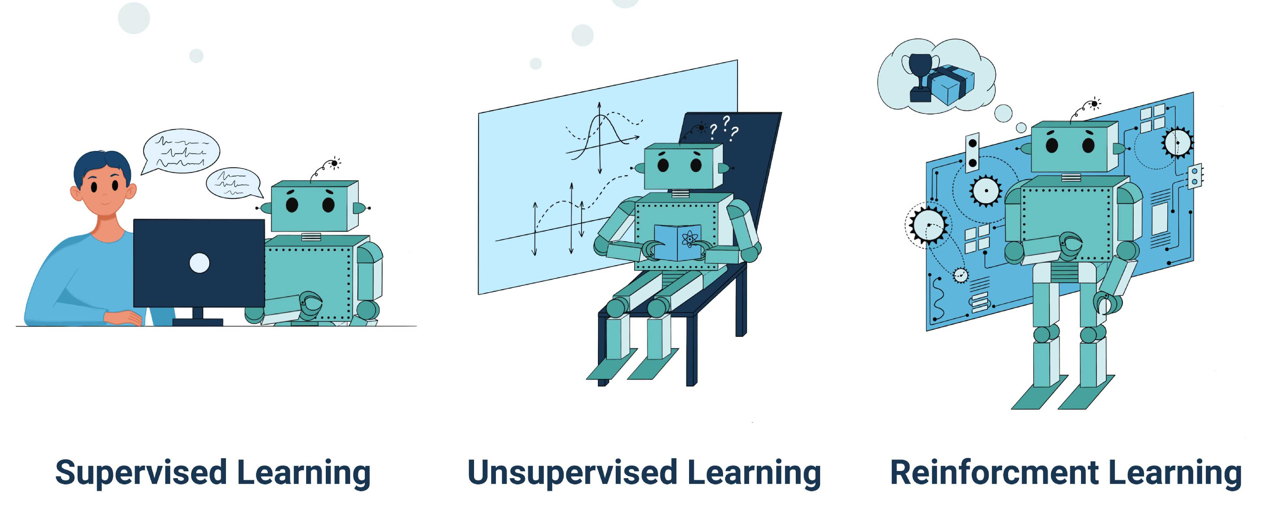
Types of Learning
Based on the methods and way of learning, machine learning is divided into mainly four types, which are:
Supervised Machine Learning
Unsupervised Machine Learning
Reinforcement Learning

Slide 5
Overview of the Source Data
Business Travel
Environment Satisfaction
Num Companies Worked
Percent Salary Hike
Total Working Years
Years At Company
Job Satisfaction
Department
Human Resources
Research & Development
Education
Field
Human Resources
Life Sciences
Job
Role
Healthcare Representative
Human Resources
Sales
Marketing
Medical
Other
Laboratory Technician
Manager
Manufacturing Director
Research Director
And more..
Personal Details
Gender
Age
Marital Status

Slide 6












Technical Architecture for building the model
ADLS Gen2
Dataset Loaded
Data Preprocessing
Training and Testing
Model Saving
Databricks
Data
Model
Datasets
Code
Report
Git Integration

Slide 7
Machine Learning Process
Test Data
Data Acquisition
Data Cleaning
Model Training and Building
Model Testing
Model Deployment

Slide 8
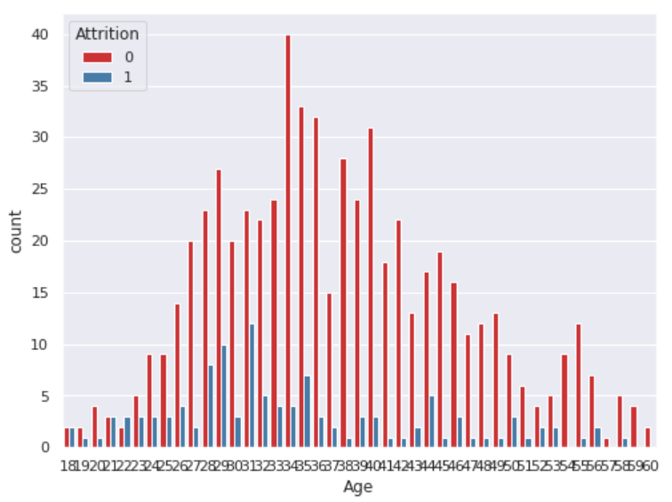
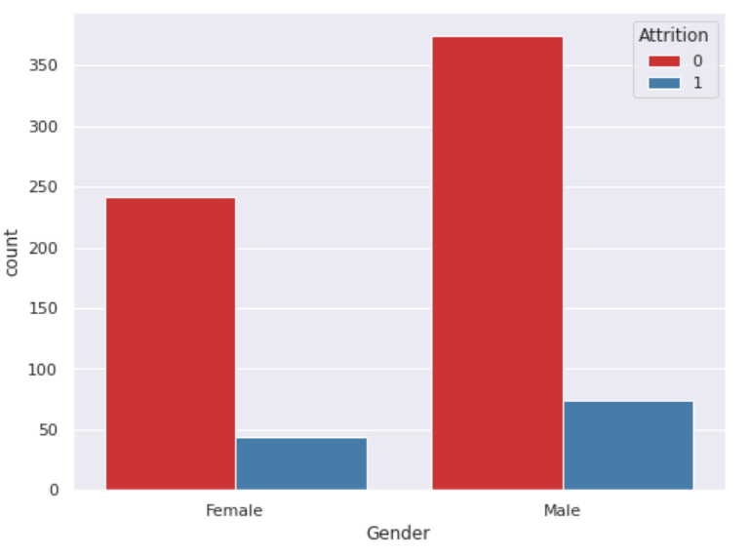
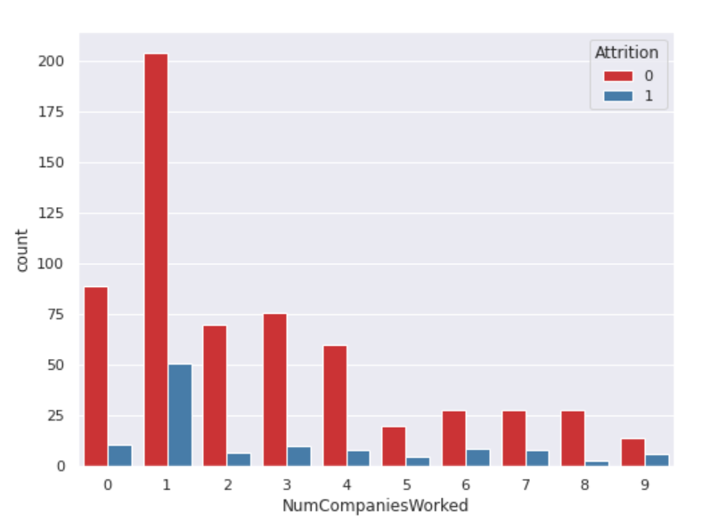
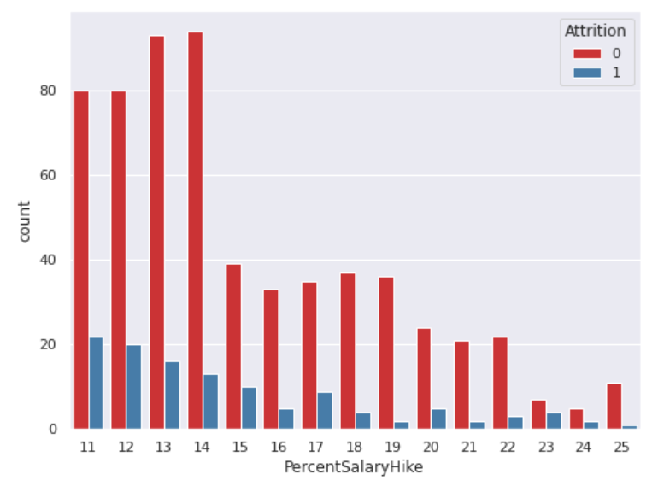
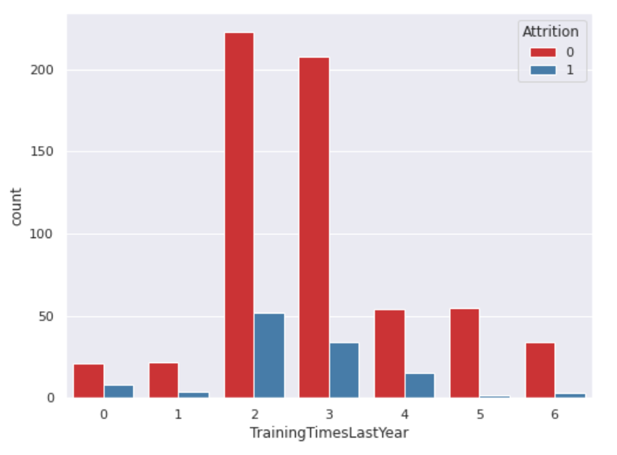
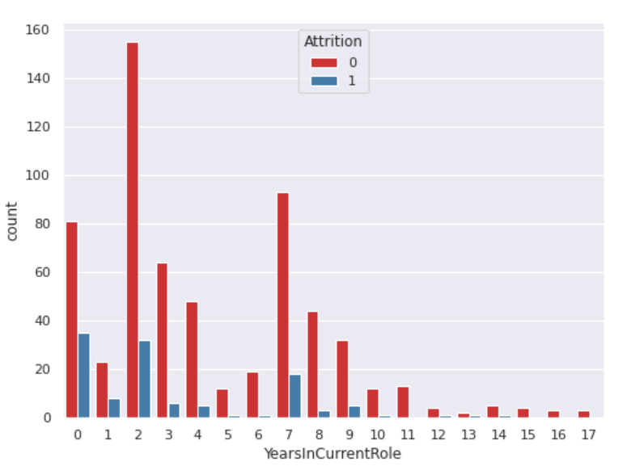
Exploratory Analysis

Slide 9
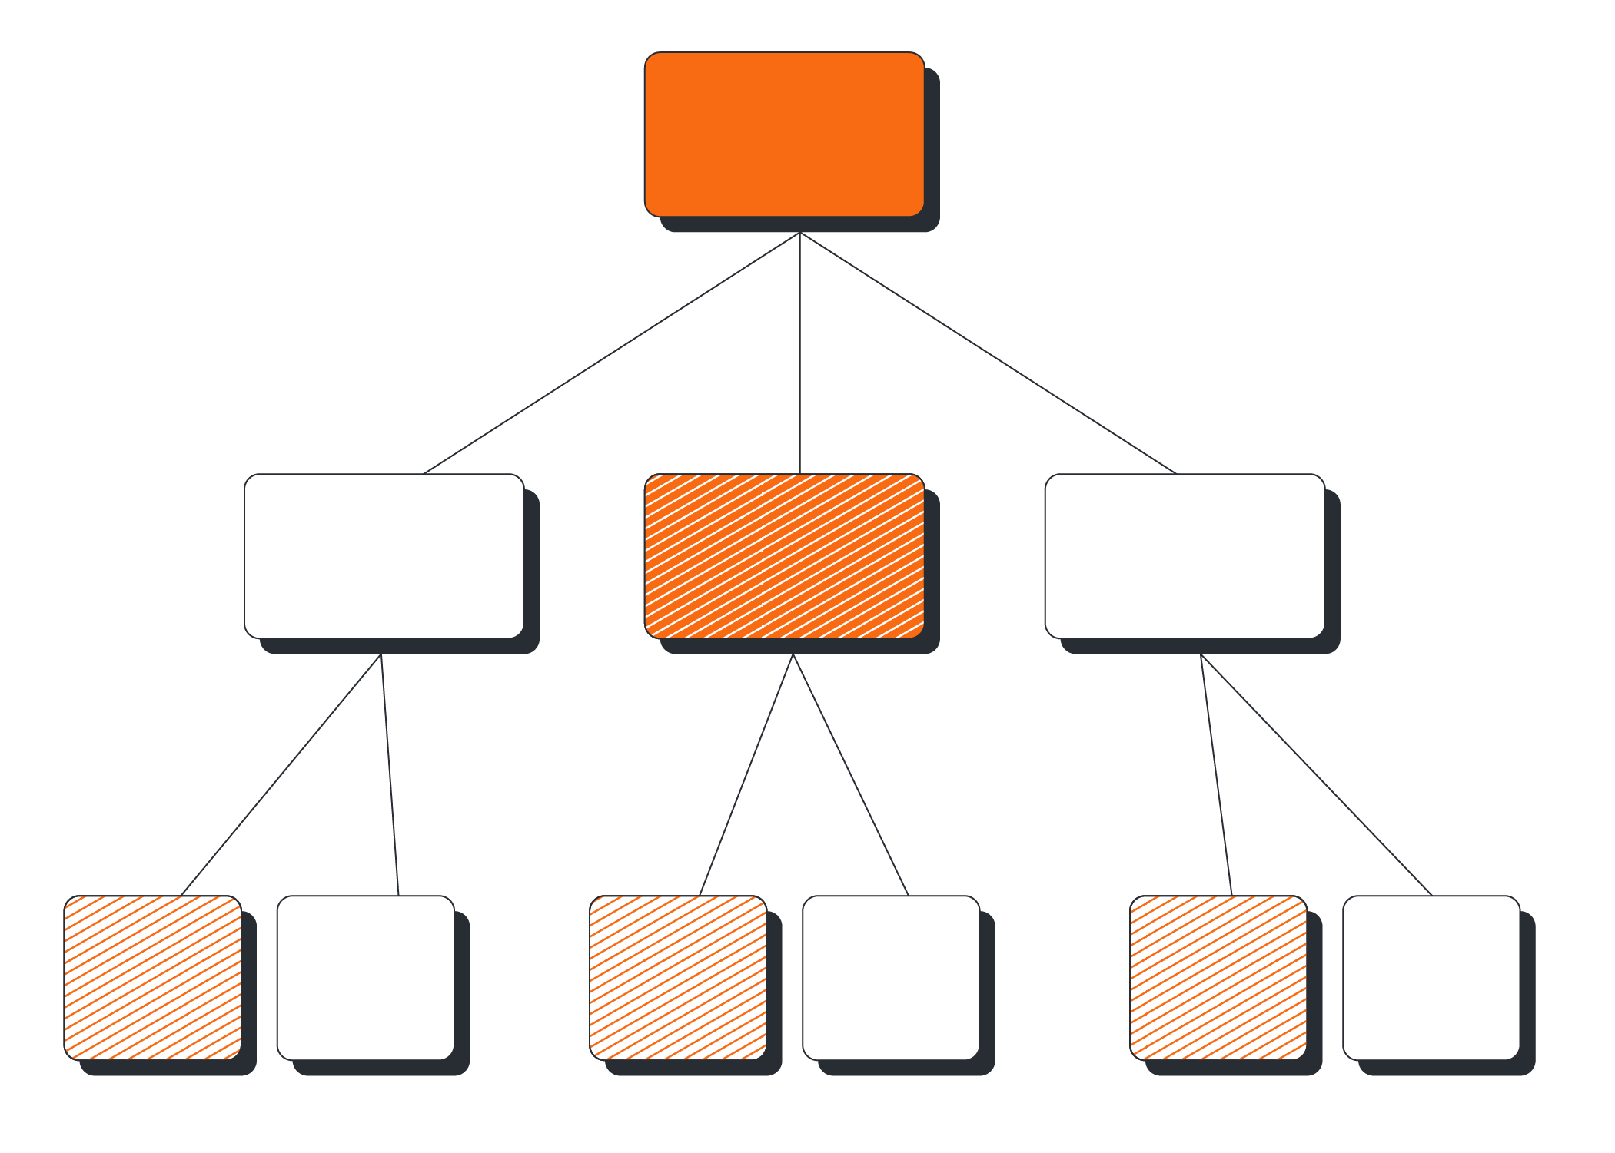
Model Used
Decision Tree
As decision trees are simple hence, they require less effort for understanding an algorithm.
They can be used to classify non-linearly separable data.
The data type of decision tree can handle any type of data whether it is numerical or categorical, or Boolean.
It is scale-invariant.
Useful in data exploration.
Decision tree is non-parametric.

Slide 10
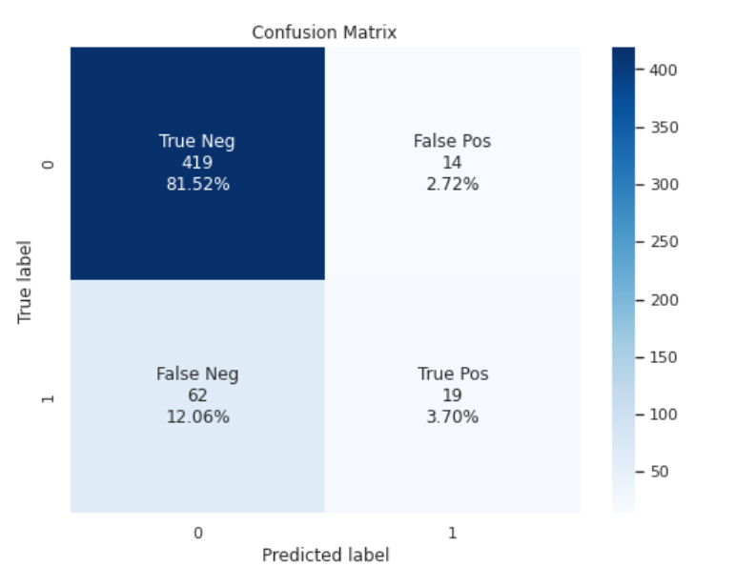
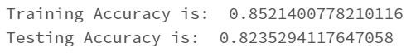
Accuracy
A much better way to evaluate the performance of a classifier is to look at the confusion matrix.

Slide 11
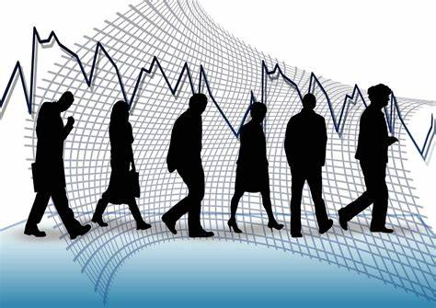
Use Case Description
A company named ABC company, is suffering from attrition in their organization. Their requirement for us to provide a predictive analysis of current employees, so that they can work with them individually and deal with the issue they might be facing while working.
And help in reducing the attrition rate across their organization.

Slide 12





Deployment of the Model
Dataset
Script
Prediction Embedded Data
Report

Slide 13
Thank You

